Slide 1
Object Oriented
Programming

Slide 2
Today’s Lecture
Introduction to Inheritance.
Purpose of Inheritance, Inheritance Advantages

Slide 3
C++ Inheritance

Slide 4
C++ Inheritance
One of the most important concepts in object-oriented programming is inheritance.
Inheritance allows us to define a class in terms of another class, which makes it easier to create and maintain an application.
This also provides an opportunity to reuse the code functionality and fast implementation time.

Slide 5
C++ Inheritance
The language mechanism by which one class acquires the properties (data and operations) of another class
Base Class (or superclass): the class being inherited from
Derived Class (or subclass): the class that inherits
The derived classes have all the features of the base class and the programmer can choose to add new features specific to the newly created derived class.

Slide 6
C++ Inheritance
Advantages of inheritance
When a class inherits from another class, there are three main benefits:
(1) You can reuse the methods and data of the existing class
(2) You can extend the existing class by adding new data and new methods
(3) You can modify the existing class by overloading its methods with your own implementations

Slide 7
C++ Inheritance
Features or Advantages of Inheritance:
Reusability:
Inheritance helps the code to be reused in many situations.
Using the concept of inheritance, the programmer can create as many derived classes from the base class as needed while adding specific features to each derived class as needed.

Slide 8
C++ Inheritance
Features or Advantages of Inheritance:
Saves Time and Effort:
The above concept of reusability achieved by inheritance saves the programmer time and effort. The main code written can be reused in various situations as needed.
Increases Program Structure which results in greater reliability.

Slide 9
C++ Inheritance
General Syntax:
class derived_classname: access specifier baseclassname
For example, if the base class is MyClass and the derived class is sample it is specified as:
class sample: public MyClass
The above makes sample have access to both public and protected variables of base class MyClass

Slide 10
Rules for building a class hierarchy
Derived classes are special cases of base classes
A derived class can also serve as a base class for new classes.
There is no limit on the depth of inheritance allowed in C++ (as far as it is within the limits of your compiler)
It is possible for a class to be a base class for more than one derived class

Slide 11
Inheritance and accessibility
A class inherits the behavior of another class and enhances it in some way
Inheritance does not mean inheriting access to another class’ private members

Slide 12
Access Control/ Visibilty modes and Inheritance:
A derived class can access all the non-private members of its base class. Thus base-class members that should not be accessible to the member functions of derived classes should be declared private in the base class.
We can summarize the different access types according to who can access them in the following way:

Slide 13
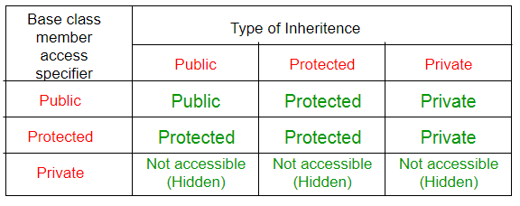
Access Control and Inheritance:

Slide 14
Visibility Modes in Inheritance
Reminder about public, private and protected access specifiers:
1 If a member or variables defined in a class is private, then they are accessible by members of the same class only and cannot be accessed from outside the class.
2 Public members and variables are accessible from outside the class.
3 Protected access specifier is a stage between private and public. If a member functions or variables defined in a class are protected, then they cannot be accessed from outside the class but can be accessed from the derived class.

Slide 15
Visibility Modes in Inheritance
When deriving a class from a base class, the base class may be inherited through public, protected or private inheritance. The type of inheritance is specified by the access- specifier.
We hardly use protected or private inheritance, but public inheritance is commonly used. While using different type of inheritance, following rules are applied:

Slide 16
Visibility Modes in Inheritance
Public Inheritance: When deriving a class from a public base class, public members of the base class become public members of the derived class and protected members of the base class become protected members of the derived class. A base class's private members are never accessible directly from a derived class, but can be accessed through calls to the public and protected members of the base class.

Slide 17
Visibility Modes in Inheritance
Protected Inheritance: When deriving from a protected base class, public and protected members of the base class become protected members of the derived class.
Private Inheritance: When deriving from a private base class, public and protected members of the base class become private members of the derived class
Notes:
A protected member is accessible by the member functions within its class and by any CLASS IMMEDIATELY DERIVED FROM IT.
Private is not visible to the inheriting class

Slide 18
Class Activity
Create a class Employee with the following attributes and member functions:
Employee registration number
Employee name
Destination
Basic salary
Profitable fund
Get the function set_ data of the registration number, name, and destination.
Inherit (public) a class salary from the employee. Salary should contain the following member functions:
Get function of basic salary, and calculate 10% of profitable fund of basic salary.
Get sum function to calculate basic salary and profitable fund.
Notes:
A protected member is accessible by the member functions within its class and by any CLASS IMMEDIATELY DERIVED FROM IT.
Private is not visible to the inheriting class

Slide 19
Header.h
#pragma once
class emp {
public:
int reg_no;
char *name;
char* dest;
int b_salary;
int p_f;
void set_data(int R,const char* N,const char* D);
};
class salary:public emp{
private:
int t_sum, calculate_pf;
public:
void set_salary(int BS);
void sum();
};

Slide 20
Source1.cpp
#include<iostream>
#include"Header.h"
using namespace std;
void emp::set_data(int R, const char* N,const char* D)
{
reg_no = R;
int length = strlen(N);
name = new char[length+1];
for (int i = 0; i < length; i++)
{
name[i] = N[i];
}
name[length] = '/0';
int length2 = strlen(D);
name = new char[length2 + 1];
for (int i = 0; i < length2; i++)
{
name[i] = D[i];
}
name[length2] = '/0';
}
void salary::set_salary(int BS)
{
b_salary = BS;
cout << " 10% Profitable fund of Basic Salary: ";
calculate_pf = (BS / 100) * 10;
cout << calculate_pf;
}
void salary::sum()
{
t_sum = b_salary + calculate_pf;
cout << endl;
cout << " Calculate PF and Basic Salary : " << t_sum;
}

Slide 21
Main.cpp
#include<iostream>
#include"Header.h"
using namespace std;
int main()
{
emp object1;
salary object2;
int reg_no, basic;
char* namee, *dest;
cout << " Enter your registration number: ";
cin >> reg_no;
namee = new char[20];
cout << " Enter your name: ";
cin.ignore();
cin.getline(namee,20);
dest = new char[20];
cout << " Enter your destination: ";
cin.getline(dest, 20);
object2.set_data(reg_no, namee, dest);
cout << " Enter your basic salary: ";
cin >> basic;
object2.set_salary(basic);
object2.sum();
cout << "\n";
system("pause");
}

Slide 22
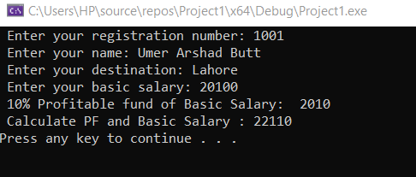
Output

